Slide 1
Clustering

Slide 2
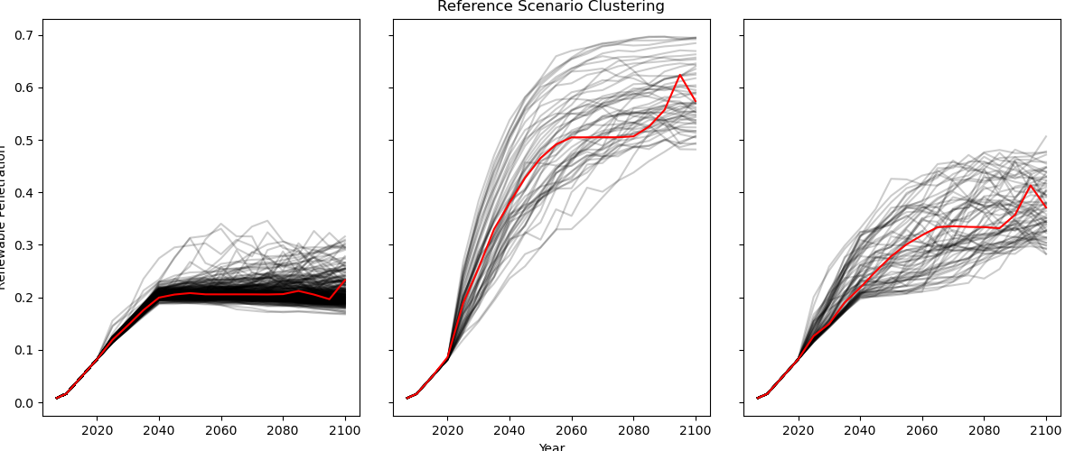

Slide 3
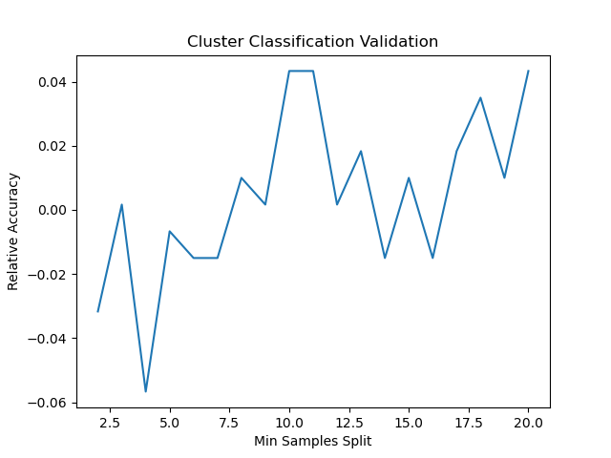
CART with clusters as labels

